Slide 1
Why Deep Learning

Slide 2
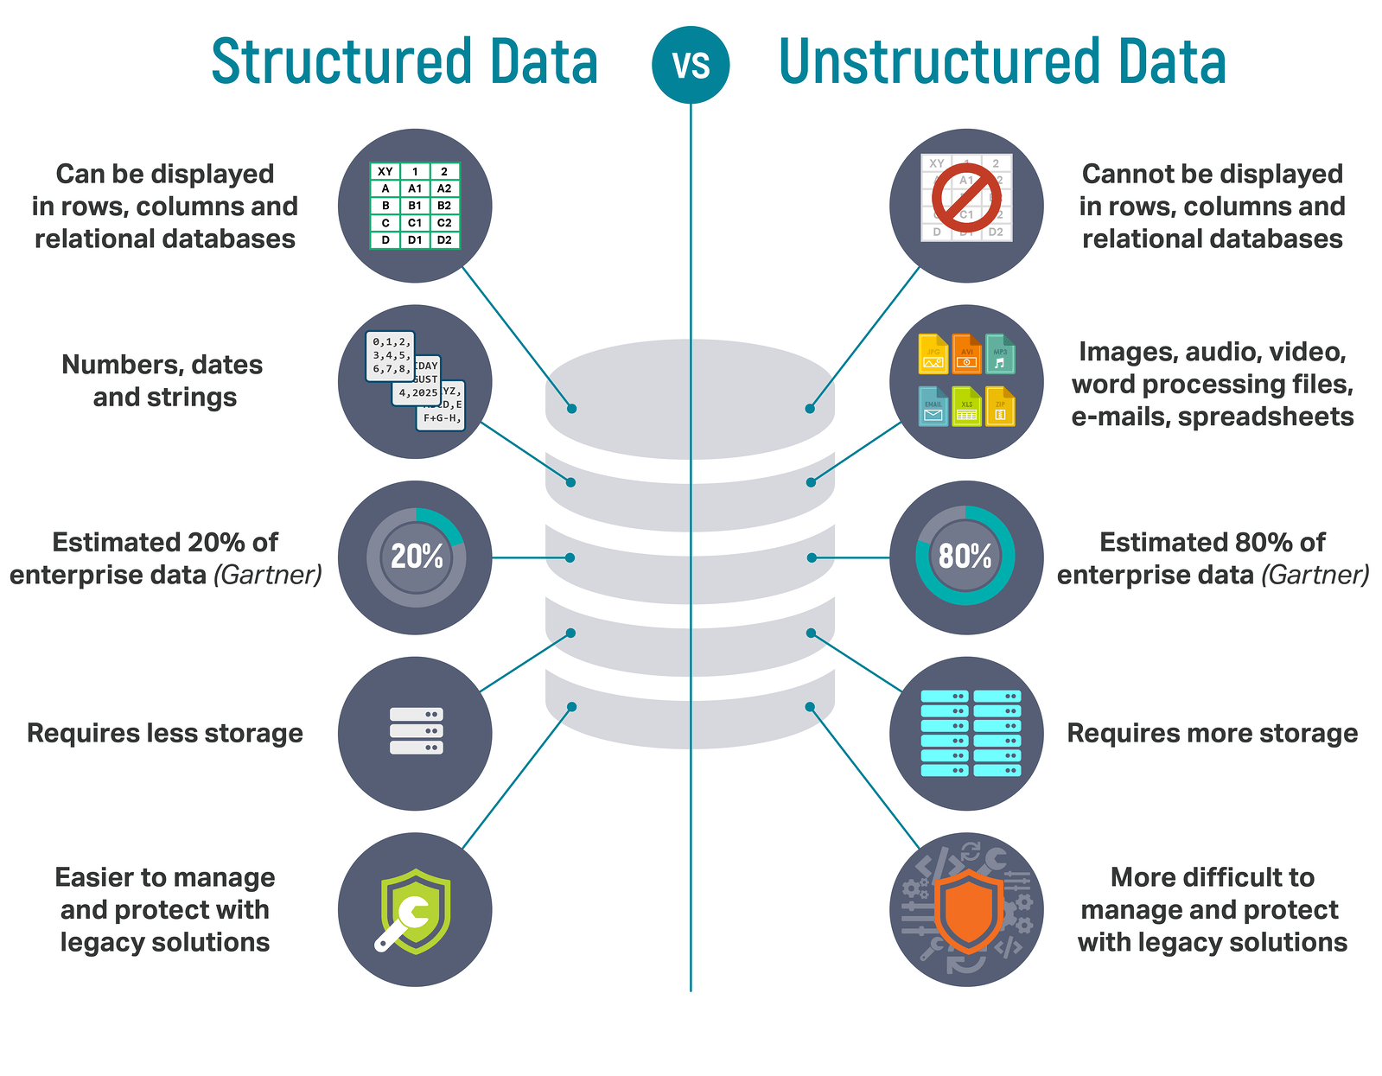

Slide 3
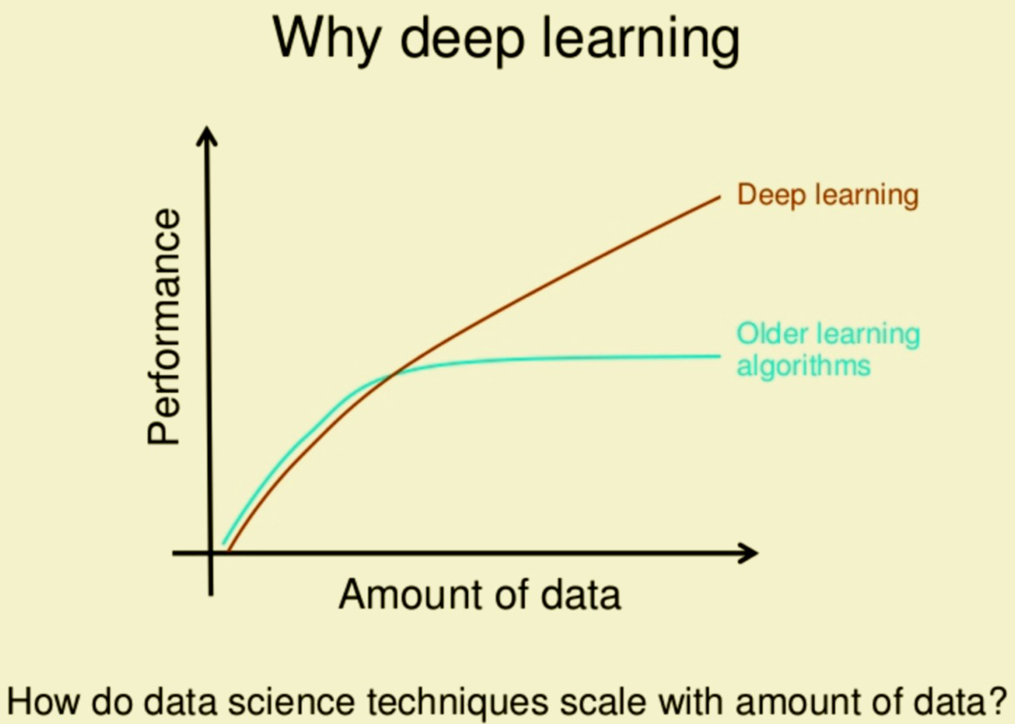

Slide 4
Deep learning is an AI function that mimics the workings of the human brain in processing data for use in detecting objects, recognizing speech, translating languages, and making decisions.
One of the main advantages of deep learning lies in being able to solve complex problems that require discovering hidden patterns in the data and/or a deep understanding of intricate relationships between a large number of interdependent variables

Slide 6
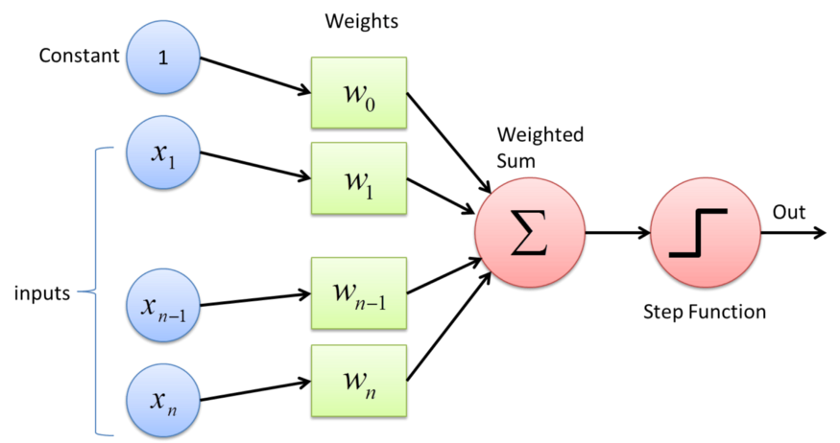
Perceptron is a single layer neural network and a multi-layer perceptron is called Neural Networks.

Slide 7
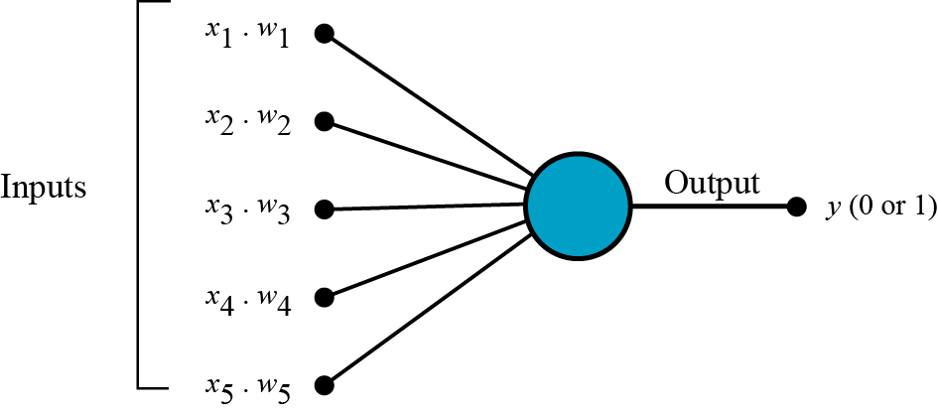
But how does it work?
The perceptron works on these simple steps
a. All the inputs x are multiplied with their weights w. Let’s call it k.
Fig: Multiplying inputs with weights for 5 inputs

Slide 8
The three most important types of neural networks are:
Artificial Neural Networks (ANN)
Convolution Neural Networks (CNN)
Recurrent Neural Networks (RNN)

Slide 9
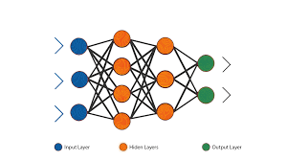
Neural Network working

Slide 10
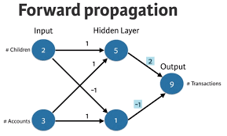

Slide 11
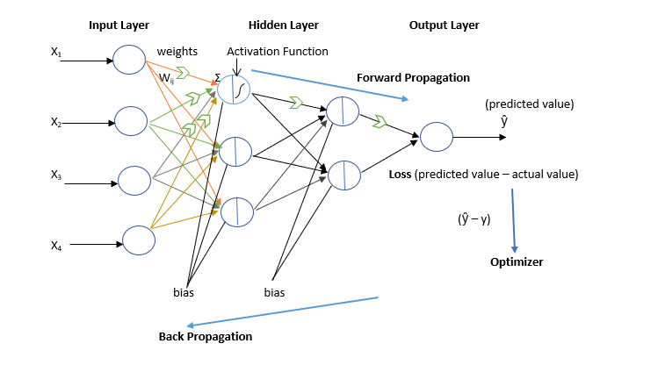

Slide 12
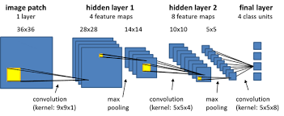

Slide 13
